Slide 1


Slide 2

#LifeKoKaroLift
SGC Coaching Week 7:
Live Coding Session - EDA
Session By:

Slide 3
Agenda: Session 1
Quick Recap –(10 mins)
Introduction and Quiz
Focused Teaching–(50 mins)
EDA Methodologies and Best Practices
Doubt resolution –(20 mins)
Discuss Individual problems

Slide 4




Focussed teaching: Points of Investigation
Different groups might need diff content
Anomaly Issues: Data Abnormalities, Logical Errors, Bias
Inconsistent Trend: Volatility, Trend analysis, Unintuitive Trend
Bivariate relationships: Driving factor, +/- influence, Important classes
Deep Dive on the right target: Hit on top values/ critical issues

Slide 5
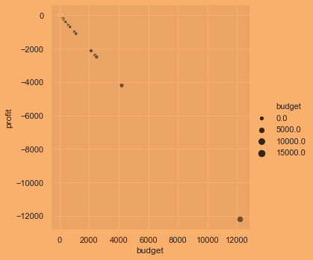
Anomaly Issues
Transformation of variables
Too many Missing values
Negative Values
Skewed Distribution (Check using Histogram)
Outlier treatment
  Use box plot(univariate)
  Use scatterplot (bivariate) (see left)
Target variable comparison across categories to highlight anomalies
  E.g. Director X features most in high profit grossing movies (IMDB case)
Correctness: Is the data in right shape/ form to answer my business questions?
Completeness: Does it capture all key events/ instances or biased?
Notes:
Explain More Real Examples to illustrate the anomalies

Slide 6
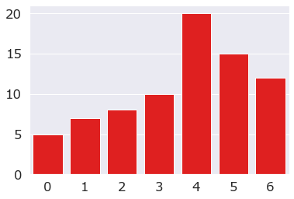
Inconsistent trend
Share examples for anomalies in trend (e.g. shocks)
Time trend analysis (preferably line chart)
  Bar chart can work well when time points are few.
Identifying the inconsistency in trends:
  Volatile pattern
  Sudden disruptive peaks/lows
  Unintuitive patterns ( flat, reverse)
Highlight it appropriately to detect the possible causes
Colour gradient can be used to highlight.
Point of Discussion: Why do we see Cyclical Fluctuations in long term data?
Notes:
Cyclical fluctuations (highs/lows) are seen in long term data as the change in economical cycles (e.g. recession)
Any other trend related example could be interesting and how to treat them if unnecessary in our analysis.

Slide 7
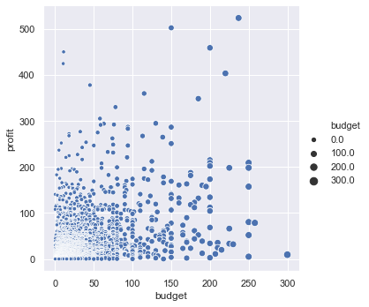
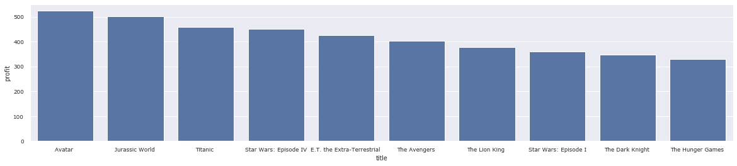
Bivariate relationships
(Explain concepts more for non-transition group)
Bivariate relationships are :
  continuous –categorical (Barplot)
  Continuous –continuous (Scatterplot)
Expected Outcome:
  Categorical: Ordering by importance
  Continuous: Driver or no driver?

Slide 8
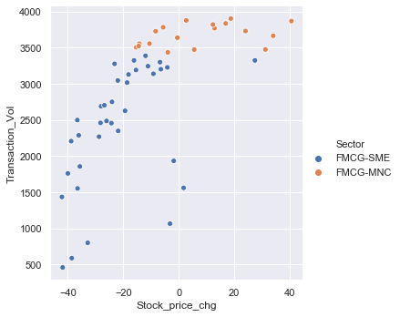
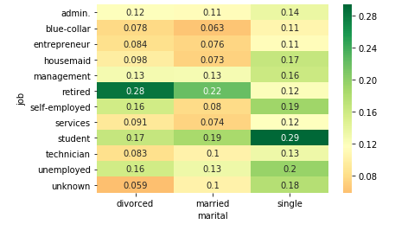
Multivariate Relationships (Pinpoint Concern Areas)
Multi-Dimensional Analysis:
Using categorical classes to compare difference in relationships
  E.g. Sector, Age, Gender splits
  Scatter/ Bar plots illustrate this well
Comparing KPIs for multiple categorical variables to determine best / worst class-combinations to target
  E.g. Education- Job
  Product-Market combinations
  Business needs to investigate sources of gain/ loss
Notes:
You can choose your own examples too for illustrations

Slide 9
Steps to follow for Exploratory Analysis
Which variables show high causation with KPI?
How do different categorical classes vary w.r.t. KPIs?
How do I prioritize entities (e.g. users/products) basis resultant metrics -KPI (e.g. profit, gross, rating)
(e.g. top 100 users)
Is there a bias in the data? Does it capture all key events/ instances?
What is the share of different classes (Only 10% online transaction data)
Is the data in right shape/ form to answer the business questions?
Notes:
You can use it to summarize the learning and share a procedure

Slide 10
LIVE CODING – STEP BY STEP EDA
Show hands on – how to perform EDA on Jupyter notebook

